Slide 1

Meritus Health FY23 Health Equity Report
March 2024

Slide 2


About Meritus Health
Meritus Health, Western Maryland’s largest healthcare provider, is located at the crossroads of Western Maryland, Southern Pennsylvania and the Eastern panhandle of West Virginia.
Serves over 200,000 residents of the tristate region (Maryland, Pennsylvania, West Virginia)
Over 3,200 Employees
Over 500 Medical Staff Members
Meritus Medical Center (MMC) – 327 beds
Meritus Medical Group (MMG) – 20+ medical practices; 180+ providers
Meritus Home Health
Equipped for Life (Medical equipment)
Mission: Improve the health of our community by providing the best healthcare, health services, and medical education.
Vision: To serve as a model community-based, academic health system.

Slide 3
Health Equity Overview
In 2003, the Institute of Medicine (IOM) published an important study entitled, Unequal Treatment: Confronting Racial and Ethnic Disparities in Health Care. This report demonstrated that even after accounting for socioeconomic factors like insurance status and income, racial and ethnic minorities still received lower quality health care than non-minority groups. This work suggests that racism, prejudice, and bias exist within the health care system, to the detriment of our patients.
Since 2003, multiple federal and non-profit organizations like the Centers for Disease Control and Prevention (CDC), the U.S. Department of Health and Human Services (HHS), the National Institute on Minority Health and Disparities, and the Agency for Healthcare Research and Quality (AHRQ) have launched initiatives to study and address health disparities at the national level. National reports continue to show that disparities in care and service exist and the COVID-19 pandemic further highlighted the pervasiveness of these disparities.
While health disparities are often viewed through the lens of race and ethnicity, it is important to note that sex, sexual identity, age, disability, socioeconomic status, and geographic location are some of the factors that contribute to an individual’s health status and can be a source of health disparities.
Health equity is a term that is related to health disparity and represents an ideal that would be realized in a world where “every person has the opportunity to attain his or her full health potential” and no one is “disadvantaged from achieving this potential because of social position or other socially determined circumstances.”
To meet the needs of everyone in our community, Meritus Health will strive to achieve health equity for all. This report provides a lens into where disparities exist in our population in order to initiate improvement efforts.

Slide 4
Executive Summary
This is the third annual Health Equity Report for Meritus Health. This report takes a deep dive into various patient outcome metrics stratified by race/ethnicity and language. Measures were analyzed by using both absolute and relative difference calculations to identify where disparities are truly present.
The FY2023 Health Equity Report analyzed 31 measures and identified 8 disparities in data spanning from July 1, 2022 - June 30, 2023. When stratified by race/ethnicity and language, the following 8 quality measures were identified as having significant differences. Analysis on each disparity can be found in the appendix of this report.
With these findings, Meritus Health will:
Launch improvement projects to address disparities
Continue the work of the LEAD Council, including:
  Ensuring 100% employee participation in unconscious bias and cultural competency training
  Increasing participation in Employee Resource Groups
  Hosting Lunch & Learns and other education opportunities
More information on this report, past reports, and other information on health equity, diversity, and inclusion
can be found at Diversity and Health Equity | Meritus Health
Measure | White | Non-White | Absolute Disparity | Relative Disparity
Pre-term birth | 8.3% | 10.1% | 1.7% | 19.0%
Newborn exclusive breastfeeding | 51.1% | 43.0% | 8.1% | 17.1%
Emergency department opioid administration | 28.2% | 19.7% | 8.4% | 35.2%
Inpatient opioid administration | 57.6% | 49.0% | 8.6% | 16.2%
Timely Medicaid appointment follow-up | 73.1% | 62.8% | 10.3% | 15.2%
Poorly controlled diabetes, HbA1c>=9% | 8.3% | 11.0% | 2.7% | 27.7%
Asthma-related emergency department visits | 0.2% | 0.7% | 0.5% | 106.2%
Measure | English | Non-English | Absolute Disparity | Relative Disparity
Emergency department left without being seen | 3.5% | 4.6% | 1.1% | 27.3%

Slide 5
Executive Summary – Past Findings
Meritus Health has made measurable improvement on health disparities identified in previous reports. Following the FY20-22 Health Equity Reports, improvement projects to address each disparity were initiated that included education and process changes.
To continue advancing health equity, Meritus Health also:
Increased engagement with our Employee Resource Groups
Provides annual mandatory Unconscious Bias training for all team members
Hosts informational Lunch & Learns on various cultural topics
Offers other DEI-related training and education on an ad-hoc basis
Measure | FY20-22 Health Disparity Findings | FY23 Progress & Areas for Improvement
Emergency department median throughput time to admit (minutes) | White / non-White patients: 16 min difference English / non-English patients: 38 min difference | White / non-White patients: 2 min difference English / non-English patients: 14 min difference
Sepsis core measure (non-compliance) | White / non-White patients: 44% relative difference | White / non-White patients: 7% relative difference
Poorly controlled diabetes (HbA1c >= 9) | White / non-White patients: 3.6% absolute difference | White / non-White patients: 2.7% absolute difference

Slide 6
Appendix

Slide 7
Summary Analysis
Within the Institute of Medicine (IOM) 6 aims for improvement framework – timely, effective, efficient, patient-centered, equitable, and safe healthcare - we analyzed 31 measures for disparities.
Sepsis core measure
Pre-term births
C-sections
Newborn exclusive breastfeeding
Emergency department opioid administration
Inpatient opioid administration
Readmissions
Mortality
Serious patient harm
Hospital-acquired infections
Emergency department median throughput time – admit
Emergency department median throughput time – discharge
Observation average length of stay
Inpatient average length of stay
Emergency department left without being seen rate
Timely Medicaid follow-up
Emergency department patient experience
Inpatient patient experience
Meritus Medical Group patient experience
Home health patient experience
Inpatient communication with doctors
Inpatient communication with nurses
Hypertension hospital encounters
Diabetes hospital encounters
Heart disease hospital encounters
Substance use-related emergency department visits
Opioid-related emergency department visits
Asthma-related emergency department visits
Opioid overdose emergency department visits
Suicide / intentional self-harm emergency department visits
Poorly controlled diabetes

Slide 8
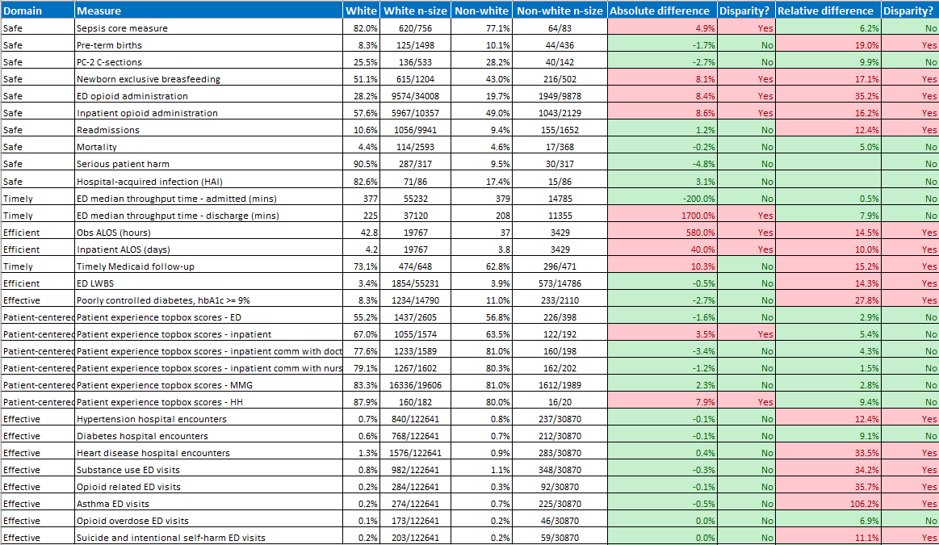
Detailed Analysis

Slide 9
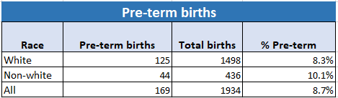
IOM Aim - Safety
Pre-term births
Analyzing the number of births that occur before 37 weeks gestational age by race from July 1, 2022 – June 30, 2023.
Absolute difference: 1.7%
Relative difference: 19.0%

Slide 10
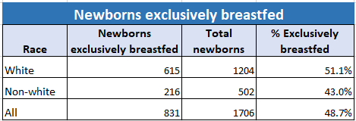
IOM Aim - Safety
Newborns exclusively breastfed
Analyzing number of newborns that were exclusively fed breast milk before leaving the hospital, analyzed by race from July 1, 2022 – June 30, 2023.
Absolute difference: 8.1%
Relative difference: 17.1%

Slide 11
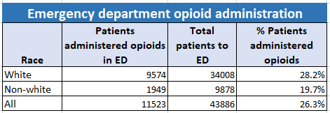
IOM Aim - Safety
Emergency department opioid administration
Analyzing the number of unique patients administered opioids in the emergency department by race from July 1, 2022 – June 30, 2023.
Absolute difference: 8.4%
Relative difference: 35.2%

Slide 12
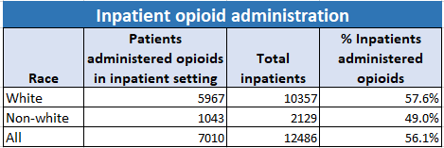
IOM Aim - Safety
Inpatient opioid administration
Analyzing the number of unique patients administered opioids in the inpatient setting by race from July 1, 2022 – June 30, 2023.
Absolute difference: 8.6%
Relative difference: 16.2%

Slide 13
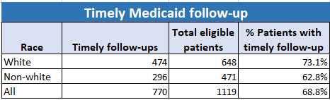
IOM Aim - Timeliness
Timely Medicaid follow-up
Analyzing timely follow-up call compliance to Medicaid patients post-appointment by race from July 1, 2022 – June 30, 2023.
Absolute difference: 10.3%
Relative difference: 15.2%

Slide 14
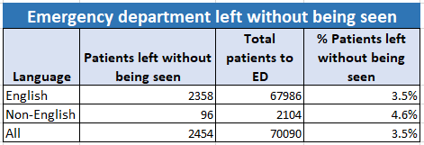
IOM Aim - Efficiency
Emergency department left without being seen rate
Analyzing the number of patients leaving the emergency department without being seen by spoken language from July 1, 2022 – June 30, 2023.
Absolute difference: 1.1%
Relative difference: 27.3%

Slide 15
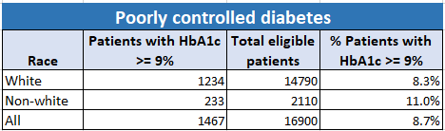
IOM Aim - Effectiveness
Poorly controlled diabetes
Analyzing the number of patients that had billable encounters with HbA1c levels greater than or equal to 9% by race from July 1, 2022 – June 30, 2023.
Absolute difference: 2.7%
Relative difference: 27.8%

Slide 16
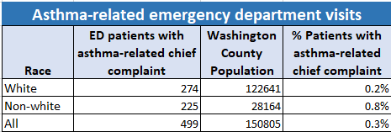
IOM Aim - Effectiveness
Asthma-related emergency department visits
Analyzing the number of patients presenting to the emergency department with asthma-related chief complaints by race from July 1, 2022 – June 30, 2023.
Absolute difference: 0.5%
Relative difference: 106.2%

